Slide 1
Introduction to unsafe C#
Calling native code and crashing in entirely new ways
Dennis Dietrich Senior Software Engineer, Microsoft
Rev. 1 (2022-06-22), https://github.com/dennisdietrich/UnsafeCSharp/

Slide 2
Overview
What is unsafe code?
Unsafe C# features
Managing unmanaged memory
Platform Invoke (P/Invoke)
Managing resource lifetime
Further resources

Slide 3
What is unsafe code? Mutating the immutable
using StringMutation;
string s = "Hello, World!";
s.AsciiToUpper();
Console.WriteLine(s); // prints "HELLO, WORLD!"

Slide 4
What is unsafe code? Code that can break the rules!
public unsafe static void AsciiToUpper(this string s)
{
fixed (char* p = s)
for (int i = 0; i < s.Length; i++)
if (p[i] >= 'a' && p[i] <= 'z')
p[i] -= (char)('a' - 'A');
}
Please don‘t try this at home in your own codebase.
If you absolutely have to try this in your own codebase, please ask a senior engineer for supervision.

Slide 5
What is unsafe code? According to the specification
"In unsafe code, it is possible to declare and operate on pointers, to perform conversions between pointers and integral types, to take the address of variables, and so forth. In a sense, writing unsafe code is much like writing C code within a C# program."
https://docs.microsoft.com/en-us/dotnet/csharp/language-reference/language-specification/unsafe-code

Slide 6
What is unsafe code? New bugs!
Buffer overflows
Access violations
Stack and heap corruptions
Dangling pointers
Use after free
Use after relocation
Memory leaks

Slide 7
Unsafe C# features Breaking down the example
// Method is declared unsafe
public unsafe static void AsciiToUpper(this string s)
{
// Pins string and gets address
// of first element of char array
fixed (char* p = s)
for (int i = 0; i < s.Length; i++)
// Pointer element access
if (p[i] >= 'a' && p[i] <= 'z')
p[i] -= (char)('a' - 'A');
}

Slide 8
Unsafe C# features Pointer operations I
// Pin array and get pointer to first element
fixed (byte* bytePtr = managedByteArray)
// Pin object and get pointer to field
fixed (int* intPtr = &_integer)
// Get address of argument
double* doublePtr = &doubleParameter;
// Get address of local
char* charPtr = &character;
// Dereference pointer
Console.WriteLine(*doublePtr);

Slide 9
Unsafe C# features Pointer operations II
Struct s = new Struct { Integer = 47, Double = 4.77 };
Struct* sPtr = &s;
// Dereference pointer and access member
sPtr->Integer = 42;
Console.WriteLine(sPtr->Integer);

Slide 10
Unsafe C# features Pointer operations III
public unsafe static void AsciiToUpper(this string s) {
fixed (char* p = s) {
char* ptr = p;
char* end = ptr + s.Length; // Pointer arithmetic
while (ptr < end) { // Pointer comparison
if (*ptr >= 'a' && *ptr <= 'z')
*ptr -= (char)('a' - 'A');
ptr++; // Pointer increment
}
}
}

Slide 11
Unsafe C# features What can you get the address of?
All value types including (generic) structs…
…as long as they don‘t contain any object references
Arrays of value types
Strings (which are arrays of char)

Slide 12
Unsafe C# features Fixed-sized buffers
// Fixed size buffer type must be one of the following:
// bool, byte, short, int, long, char, sbyte
// ushort, uint, ulong, float, double
public unsafe struct FixedBuffer
{
public int Integer;
// Type of ByteBuffer is byte*
public fixed byte ByteBuffer[128];
}
// Allocate memory from call stack and return address
byte* byteArray = stackalloc byte[1024];
Guid* guidArray = stackalloc Guid[128];

Slide 13
Unsafe C# features Explicit struct layout I
// Assuming a little-endian system
[StructLayout(LayoutKind.Explicit)]
public struct Union
{
[FieldOffset(0)] public ushort Value;
[FieldOffset(0)] public byte LowByte;
[FieldOffset(1)] public byte HighByte;
}
Union u = new() { Value = 0xBEEF };
Console.WriteLine($"{u.HighByte:X2}"); // Prints "BE"
Console.WriteLine($"{u.LowByte:X2}"); // Prints "EF"

Slide 14
Unsafe C# features Explicit struct layout II
[StructLayout(LayoutKind.Explicit)]
public unsafe struct ReinterpretCast
{
[FieldOffset(0)]
public long Long;
[FieldOffset(0)]
public double Double;
[FieldOffset(0)]
public void* Ptr;
}
ReinterpretCast c = new() { Long = 47 };
Console.WriteLine(c.Double); // Prints "2.3E-322"

Slide 15
Managing unmanaged memory The .NET 6 way
unsafe
{
// Allocate heap memory using
// C standard library function malloc()
void* ptr = NativeMemory.Alloc(1024);
// Free heap memory using C standard library function free()
NativeMemory.Free(ptr);
}

Slide 16
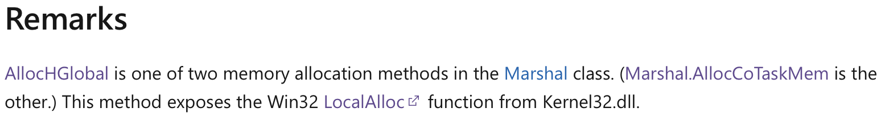
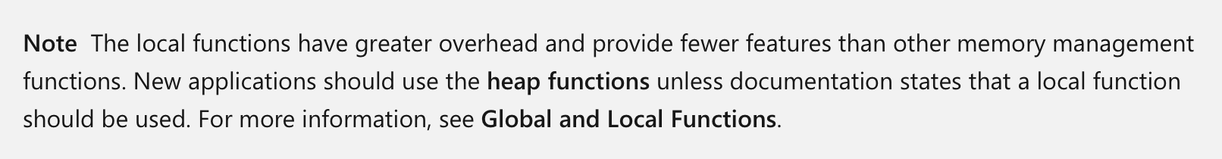
Managing unmanaged memory The .NET Framework way
// The following code is not unsafe:
// Allocate memory from default heap
IntPtr ptr = Marshal.AllocHGlobal(1024);
// Free memory
Marshal.FreeHGlobal(ptr);

Slide 17
Managing unmanaged memory The Win32 way
// Retrieves a handle to the default heap of the calling process.
HANDLE GetProcessHeap();
// Allocates a block of memory from a heap.
DECLSPEC_ALLOCATOR LPVOID HeapAlloc(
_In_ HANDLE hHeap,
_In_ DWORD dwFlags,
_In_ SIZE_T dwBytes);
// Frees a memory block allocated from a heap
// by the HeapAlloc or HeapReAlloc function.
BOOL HeapFree(
_Inout_ HANDLE hHeap,
_In_ DWORD dwFlags,
__drv_freesMem(Mem) _Frees_ptr_opt_ LPVOID lpMem);

Slide 18
Platform Invoke (P/Invoke) DLL imports
internal static class Kernel32 {
internal static readonly IntPtr HeapHandle =
GetProcessHeap();
[DllImport("Kernel32")]
internal static extern IntPtr GetProcessHeap();
[DllImport("Kernel32")]
internal static unsafe extern void* HeapAlloc(
IntPtr hHeap, uint dwFlags, nuint dwBytes);
[DllImport("Kernel32")]
internal static unsafe extern int HeapFree(
IntPtr hHeap, uint dwFlags, void* lpMem);
}

Slide 19
Platform Invoke (P/Invoke) Calling external functions
using static MemoryManagement.Kernel32;
unsafe
{
void* ptr = HeapAlloc(HeapHandle, 0, 1024);
if (ptr == null)
throw new OutOfMemoryException();
HeapFree(HeapHandle, 0, ptr);
}

Slide 20
Platform Invoke (P/Invoke) Data type resources
Header files
The Data Type Ranges page of the C++ language reference https://docs.microsoft.com/en-us/cpp/cpp/data-type-ranges
The Windows Data Types page of the Win32 documentation https://docs.microsoft.com/en-us/windows/win32/winprog/windows-data-types

Slide 21
Platform Invoke (P/Invoke) Code generators
For Win32 APIs on .NET 6: C#/Win32 "A source generator to add a user-defined set of Win32 P/Invoke methods and supporting types to a C# project." https://github.com/microsoft/CsWin32
From C/C++ header files: SWIG "SWIG is a software development tool that connects programs written in C and C++ with a variety of high-level programming languages. […] The list of supported languages also includes non-scripting languages such as C#, D, Go language, Java including Android, Lua, OCaml, Octave, Scilab and R." https://www.swig.org
Full discloser: I haven’t used either

Slide 22
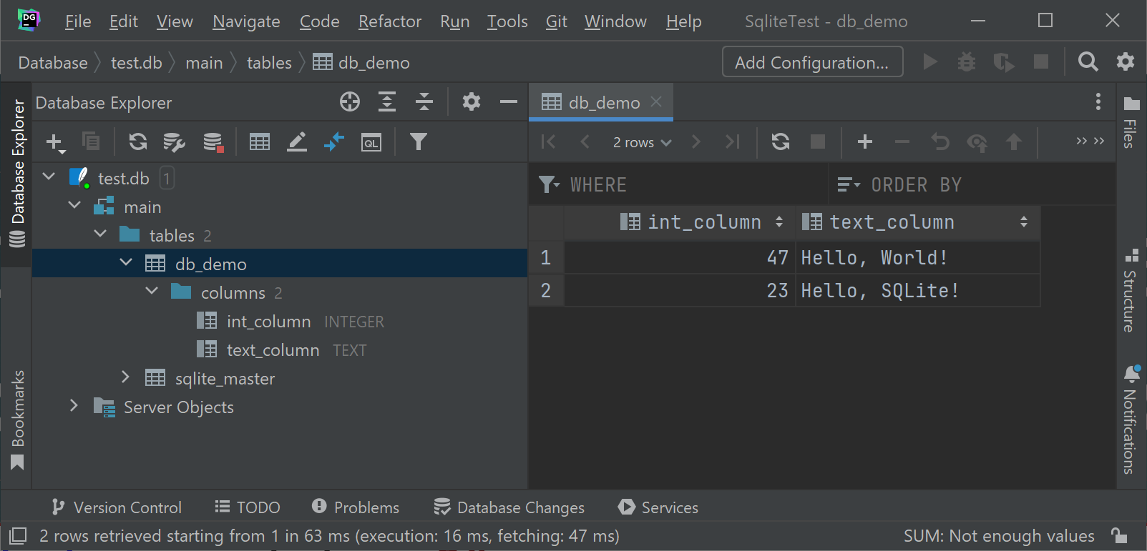
Managing resource lifetime Example: SQLite database
string script = @"
CREATE TABLE db_demo (int_column INTEGER, text_column TEXT);
INSERT INTO db_demo (int_column, text_column)
VALUES (47, 'Hello, World!');
INSERT INTO db_demo (int_column, text_column)
VALUES (23, 'Hello, SQLite!');";
using Database db = new Database("test.db");
db.Execute(script);

Slide 23
Managing resource lifetime SQLite API
internal unsafe delegate int Callback(
void* ptr, int columns, out byte* values, out byte* names);
[DllImport("sqlite3", EntryPoint = "sqlite3_open")]
internal static extern int Open(
[MarshalAs(UnmanagedType.LPUTF8Str)] string filename,
out SafeDatabaseHandle pDb);
[DllImport("sqlite3", EntryPoint = "sqlite3_close_v2")]
internal static extern int Close(IntPtr pDb);
[DllImport("sqlite3", EntryPoint = "sqlite3_exec")]
internal static unsafe extern int Execute(SafeDatabaseHandle pDb,
[MarshalAs(UnmanagedType.LPUTF8Str)] string sql,
Callback? callback, void* firstArg, byte** errMsg);

Slide 24
Managing resource lifetime What‘s a safe handle?
"Represents a wrapper class for operating system handles." https://docs.microsoft.com/en-us/dotnet/api/system.runtime.interopservices.safehandle
…but works just as well with pointers! :)
Is a CriticalFinalizerObject https://docs.microsoft.com/en-us/dotnet/api/system.runtime.constrainedexecution.criticalfinalizerobject
Runs finalization in a Constrained Execution Regions (.NET Framework only) https://docs.microsoft.com/en-us/dotnet/framework/performance/constrained-execution-regions
P/Invoke infrastructure reference counts usage

Slide 25
Managing resource lifetime SafeDatabaseHandle
internal sealed class SafeDatabaseHandle : SafeHandle
{
public override bool IsInvalid => handle == IntPtr.Zero;
internal SafeDatabaseHandle() : base(IntPtr.Zero, true) { }
protected override bool ReleaseHandle() =>
Sqlite.Close(handle) == 0;
}

Slide 26
Managing resource lifetime Database wrapper class I
public sealed class Database : IDisposable
{
private readonly SafeDatabaseHandle _databaseHandle;
public Database(string filename)
{
if (Sqlite.Open(filename, out _databaseHandle) != 0)
throw new Exception("Failed to open database.");
}
// Look mom! No finalizer!

Slide 27
Managing resource lifetime Database wrapper class II
public unsafe void Execute(string sql)
{
// Look mom! No 'disposed' check!
if (Sqlite.Execute(
_databaseHandle, sql, null, null, null) != 0)
throw new Exception("Script execution failed.");
}
// No need for overloads since the class is sealed.
public void Dispose()
{
if (_databaseHandle?.IsInvalid == false)
_databaseHandle.Dispose();
}
}
Always call Dispose().
Do not rely on the finalizer.

Slide 28
Further resources
Unsafe code, pointer types, and function pointers https://docs.microsoft.com/en-us/dotnet/csharp/language-reference/unsafe-code
Unsafe code (C# language specification) https://docs.microsoft.com/en-us/dotnet/csharp/language-reference/language-specification/unsafe-code
Native interoperability https://docs.microsoft.com/en-us/dotnet/standard/native-interop/

Slide 29
Questions?

Slide 30
Thanks for listening!

